Slide 1
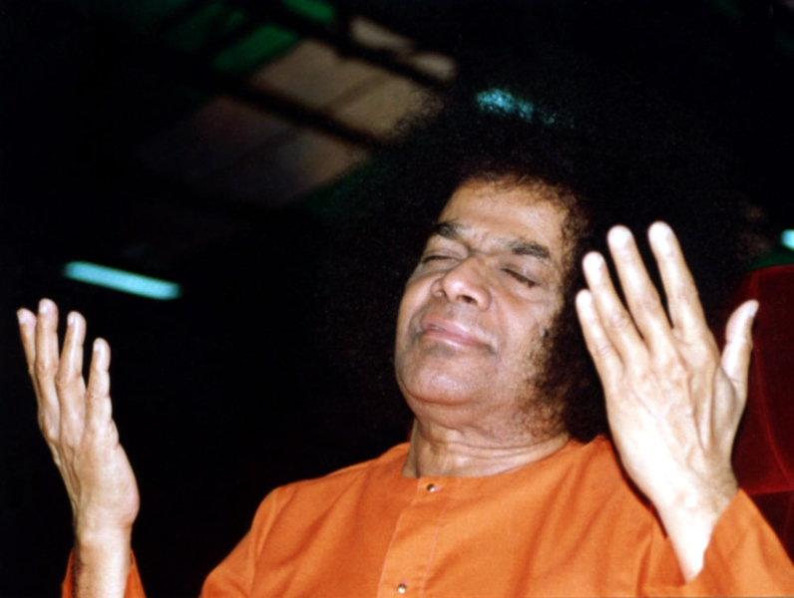
.
OM SRI SAI RAM
Sathyam
Shivam
Sundaram

Slide 2
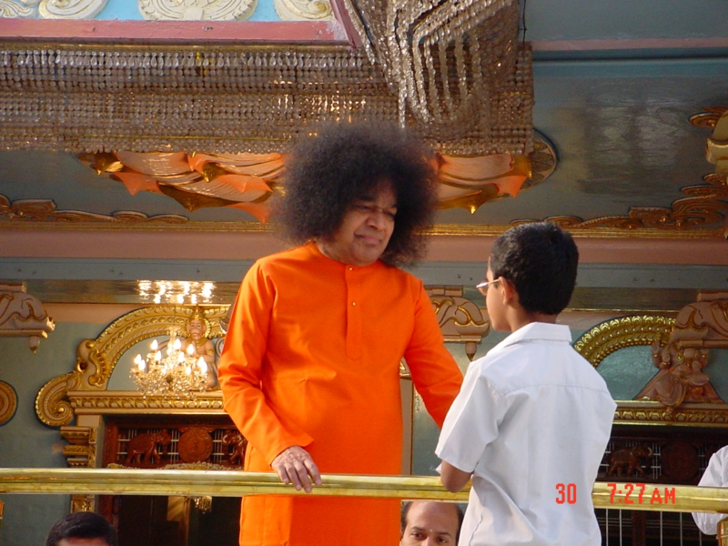
CHAPTER-6
BALA SAI

Slide 3
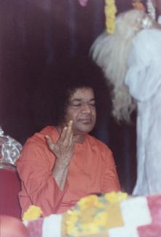
As Swami himself mentioned ,the first sixteen years of his life will be marked mainly by Leelas, next by his miracles and the subsequent years by his upadesham(messages).
Our dearest swami ( incarnation of shirdi sai ) belonged to Bharadwaja Gothram and the Apasthamba Suthram.His origin name was sathyanarayana raju, but he commonly came to be known as Bala Sai or Sathya Sai Baba. His father name was Pedda Venkapa Raju.Bhajans were done in presence os swami not only on Thursdays evening ,but gradually everyday or some times twice a day.

Slide 4
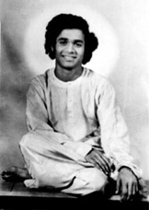
Once a recruiting officer came in a jeep for baba’s darshan ,giving the villegers their first contact with a self – propelled vehicle. But here came the first obstacle of the sitting place for the devotees. At first the devotees used to gather in Pedda Venkapa Raju home ,then gradually the roads too was being filled to overflow .
To the solution for this issue the family of karnam put up a shed ,which was strengthened as the months passed. Even a tent was rigged up and some devotees who came from banglore and anantpur brought and pitched their own tents.

Slide 5
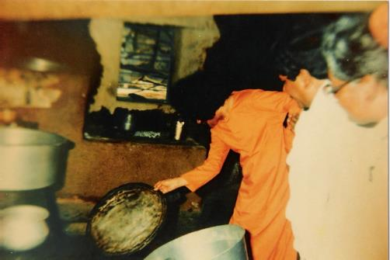
The spacious house of Karnam even became insufficient because baba insisted on feeding all those who came to see him,and the huge dining hall became necessary.
Very often ,when the food was cooked seemed to be too less in quantity,swami was quietlt informed about the incident he asked two coconuts to be brought to him,as the coconuts were given to him he struck the coconuts one against the other and they broke into two halves,he then sprinkled the coconut water on the little heaps of rice and the vessels containing other items and gave them the signal to proceed with the serving of the food to all the devotees

Slide 6
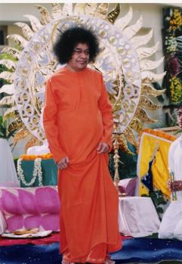
A devote from Kamalapuram was asking baba to show him some miracles and one day ,Baba called him and his family and offered to show them the dhshaavatar
The ten incarnation of Vishnu,Matsy,Kurma, and Varaha passed off without any incident but when form of Naraghsiama appeared they shrieked and faring of house might collapse on. their heads .
The Dashaavatar Form were vouchsafed to another gentleman , as a matter of fact he passed away ,because his physical frame was too weak to contain the joy of the vision.

Slide 7
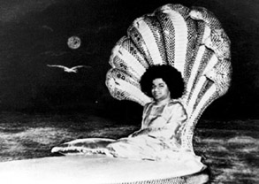
Baba was then at Bangalore ,there was a little boy of.he was very enthusiastic member of bhajan group.one day he ask swami that “I know you are a god ;show me your divine form”.
First baba avoid him but after many request baba gave him a picture of “Shirdi Sai Baba” and direct him to mediated and by commanding baba left the house.
At 12 swami came back .and he saw that that man raised a huge cry of joy .he kept his eyes tightly closed and pursuing baba room –to-room and asking ,“Give me padd namaskar!”
Swami asked him to open his eye but he refuse .swami told him that if he touched his feet while in that ecstatic mood he would passed away soon.

Slide 8
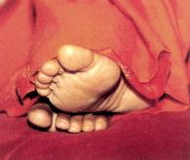
His eye capsuled for many days and because of this one day he was taken to hospital .baba send him a littelm Padatirtham , he drank it and then he became fit enough to taken home.
At home he asked everyone to do bhajan ,himself lying on a cot in the same room.when the bhajan was over they found he did nor rise.he had touched the feet of the lord.
“The river had found the sea.”

Slide 9
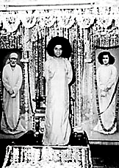
One day some people came to Puttaparti .the people initially don’t believe on swami .They told that it is dark magic .
Baba coolly asked the Venkapa Raju to bring everyone who had any doubt ,direct to him.
Baba asked them if they would like to see the Shirdi sai Samadhi .and on there saying Yes ,he took them inside the room.
He said ‘LOOK’’ and there they could see the Samadhi with the flower Incense stick with smoke and fragrance.

Slide 10
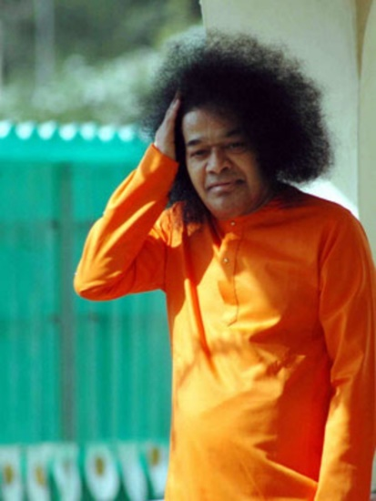
Baba was engaged even during those days in upadesh .a clear example of this he gave to Digambara Swami when he came to puttaparti .
When digambara swami met to swami .swami gave the unclothed a towel and some advice to digamabara.
“if you have cut down the relationship with society ,as your nakedness indicates ,then why you do not go to cave or forest .”they stuck everyone with wonder and admiration.
The Digambra Swami was not able to answer baba question ,then swami said that “I know your difficulty. You are afraid you may not get shelter and food. Well I assure you who ever take god name ,wherever he will get food.”

Slide 11
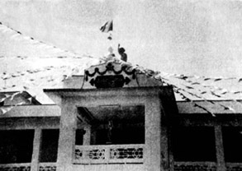
As the became popular among people ,the no of devote who are visiting puttaparti was increasing .there was no place for there stay.
There was a need of bigger mandir where baba could reside and devotee can accommodated .This how the old mandir got planned by Tirumala Rao of Bangalore and other in 1945.

Slide 12
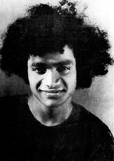
Baba tells that LINGAMS are all in his stomach.The people who have witnessed the emanation of lingams from baba’s mouth on the night of shivaratri
Baba went to MASULIPATNAM. He visited the seashore, then he walked straight into the sea, the devotees took some time to realise the situation. Then, heard the voice of thunder towards the waves, they a vision of sheshashayee (the lord of serpent shesha) next second baba was by their side.
They couldn’t believe the fact that his clothes were not at all wet. Next day he went to the seashore and took a silver cup, threw far into the waves, the cup came back. Baba lifted up along with saltwater and gave it to the devotees, each of them found it fragrant and sweet.

Slide 13
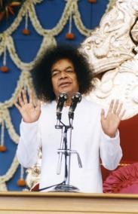
One incident that happened at Bengaluru…….
Baba stayed in a bungalow, just opposite to this there was a cobbler in a small hut .one day the cobbler ventured to enter the gate and peep nervously into the hall, where baba was seated, his eyes fell on baba just when baba looked at him, baba got up from the chair and started moving towards him, baba asked him in Tamil “What do you want from me”.
He said please come to my house and accept something then he waited for baba to come, after many days baba makes a visit to his home giving him fruits and sweets as prasadam. This shows baba’s prema.

Slide 14
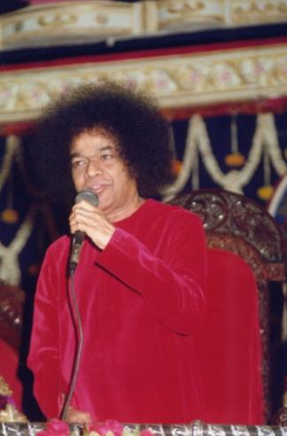
But there are some people who attempted to give poison to baba, but baba will not allow the attempt to be called an “an attempt to kill” and his words are truth we shall repeat that it was just an attempt to test that he could survive by eating poison.
Subbamma was the person most anxious about babas health and most worried about the hundreds of pilgrim ‘s who gathered at puttaparthi.
Subbamma fell ill, she was taken to bukkapatnam but in spite of her illness she came over one day in a bull-cart to see the prashanthi nilayam. She was bed ridden. she could not move, her condition worsened. Baba was away (Bangalore). subbamma in her delirium talked about baba and the vision of shiridi sai which she had been privileged to see, of the manifold of the Krishna she had witnessed

Slide 15
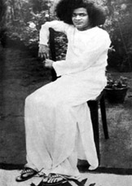
When she came back to her sense’s her talk was about the same incident and same person.
Baba was 100 miles away. Meanwhile baba left Bangalore to tirupathi. Where he spent time with his devotees of course baba knew that subbammas soul was struggling to free itself from mortal coil and that she was rolling in her deathbed in bukkapatnam. The people announced that she had her last breath but some peculiar glow in her face made them nervous to take her to cremation ground. A few wiser people shook their heads when it was said that she died. They told that “The bird hasn’t flown yet, how could the bird not fly even though the door of the cage was open.’’

Slide 16
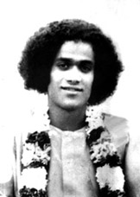
She must have the darshan and she must wait until baba come. And baba was too hurrying towards her bedside and sat by her side and in a low voice he called “SUBBAMMA SUBBAMMA” just twice and no more then SUBBAMMA opened her eyes ,her hand extended towards baba and grasped his palm firmly and being to stroke it lovingly, baba put his fingers in her lips , her mouth opened a little as she knew that baba was giving her something to slake the thirst of the soul from the fingers of baba there poured into her mouth the immortal ganga and SUBBAMMA joined the ranks of released .

Slide 17
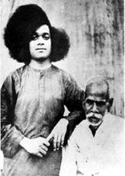
The possessed muslim:
When muslims were proceeding from mandir, after accepting Pirs from Baba’s hands, the person who carried them began to act like ‘possessed’ and all started to gather around him, to watch the holy man in that elevated mood. He danced, ran round in circles, muttered the Holy Quran to himself and walked back to Baba.
Devotees would come to puttaparthi from far or near, each one was drawn from his place by some inexplicable circumstances for the glimpse of Baba’s Omniscience, or Omnipresence, or Omnipotence.

Slide 18
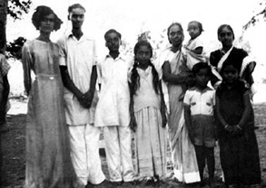
The story of Operation:
A gentleman from Madurai came to Parthi , as his sister at Vellore accepted to have an operation performed on her only if Baba agreed it was essential. He came to Parthi, Baba didn’t speak to him for few days, at last when to spoke, he only asked him to go back to vellore by the next bus. The Doc was furious cause the silly patient was endangering her own life, waiting for the HUKUM of a Boy, who she says is her Guru and God! The Brother came at last. Another examination was made; and wonders of wonders, there was no need for an operation.
The story of Smt. Sakamma, famous coffee planter and philanthropist of Coorg, honorary of the title Dharmaparayani by the Maharaja of Mysore.
Baba does not mind a person being rich, nor being poor. He cares for the richness of character, the wealth of sadhana, the treasure of spirit.

Slide 19
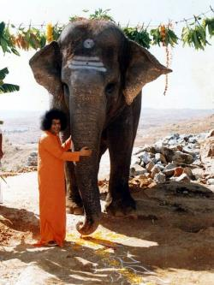
The late Smt. Sakamma used to tell this strange story that she experienced. One day at her own banglow in Somawarpet, Coorg, when she was engaged in worship, a servent disturb her an announced that a car had come into the compound and the person inside insisted on seeing her immediately. She was rather upset, but never the less went out to find who could take such liberty with her time table. She found in the car a tall, fair, old man with a very reverend beard, sitting on the deerskin, his whole body bathed in ash. She was struck by the age of the car too, for it matched the age of the owner or occupant. The car was driven by a weak little boy in his teen and Smt. Sakamma wondered how he could have managed to secure a licence or whether he had one at all. The car had a name plate on top in front, “THE KAILASH COMMITTEE!”.

Slide 20
Venkatanarayanan
At a public in Trichinopoly, which was held to Baba, someone doubted about his divinity, sensing this from the platform, Baba immediately called up deaf & dumb lad, who was standing near the aforesaid person, and making him stand in front of the mike, He asked him ‘what is your name?’ immediately the boy spoke into the mike for all the thousands to hear, “Venkatanarayanan1” The doubter swallowed his tongue and hung his head in shame, but there was another consequence too. For, when the morning dawned, the entire length of the street where He was residing was packed with the dumb and deaf ! It had been a silent lane of pain!

Slide 21
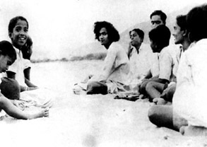
Dasara soon became the festival par excellence at puttaparthi,
srimati sakamma and other devotees were privileged for many year to make arrangements for this festival of the mother.
Baba has said that sanathana dharma is the divine mother of humanity with his message of Sathya, Dharma,Shanti,Prema.
He offers the child a ball of sand it reluctantly extend its tiny hand to receive laddu as he calls it the sand actually becames sweet fragrant laddu the moment it reaches the palm of the child.
When baba agrees to name the children of his devotees, the name he gives them are redolent of his grace and his mercy
There is a tamil song on baba, which refers to him as the Sayimata, the mother who suckles her children on the milk of Guyana.
Baba shines forth as the patron of music and letters, and as the giver of food and sustenance, during dasara, and so, it is a memorable festival, from the very beginning of this manifestation
Baba plucking from the garlands around him odd flowers and, with a palm full of petals, scattering them for a crowd, for each petal had become a small medallion with baba’s portrait on one side and shirdi sai baba’s portrait on the other

Slide 22
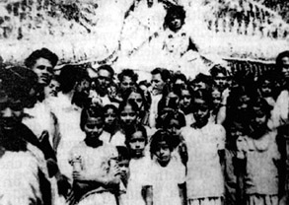
Many worshippers of shirdi sai baba, on hearing that he had incarnated in human form in the village of puttaparthi . many who went to pilgrimage to shirdi as usual, were directed there to go to puttaparthi istead. Other got know the baba of shirdi through sathya sai baba himself.
His vibhuti acts as a charm to drive away evil spirits and the effects of black magic from hundreds of unfortunates.
A long shed had to be put up within a few years in front of the mandir. A separate block, with one living room and bath room was put up for baba, behind the mandir. It was in this room that baba operated on Dr. Padmanabhan’s brother for hernia, it was in the shed that behind the screen in front of the shrine that baba operated on Appiah of puttaparti for appendicitis.

Slide 23
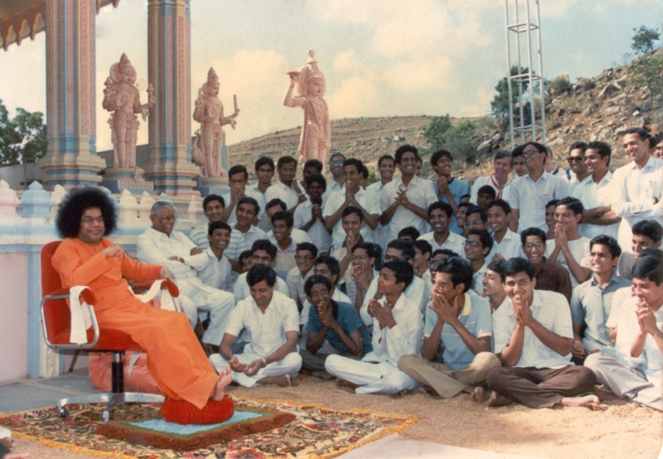
THANK YOU
SAI RAM…..

